Slide 1



Slide 2
PRODUCT INTRODUCTION

Slide 3
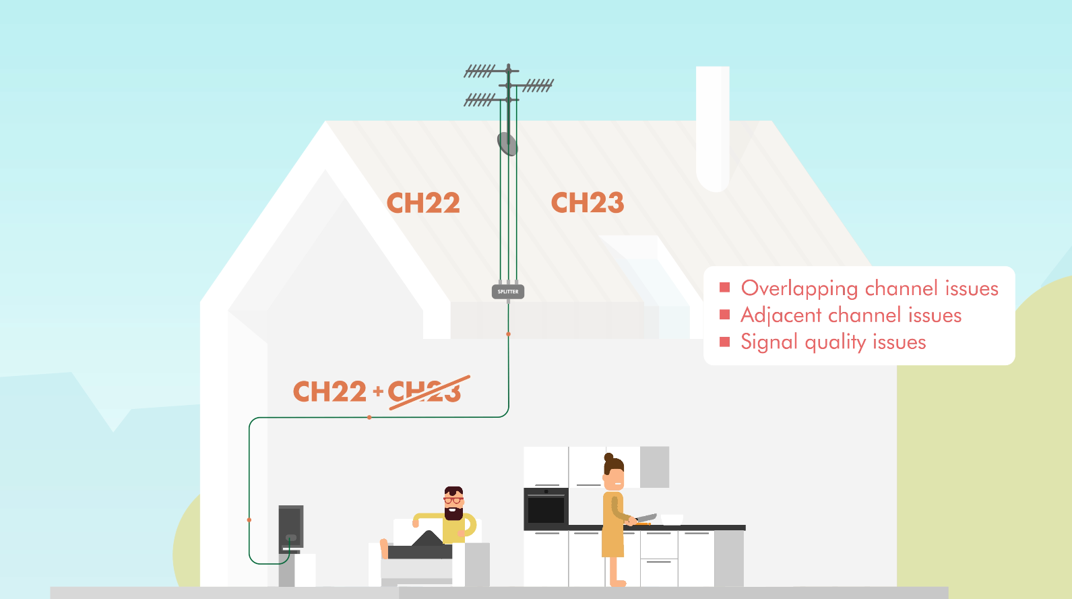

TRADITIONAL INSTALLATION
Channels with same Channel Number are lost
Poor isolation between adjacent channels
Signal quality issues
  Lots of interruptions
  Loss of 4dB (min) when combining antenna
PATENTED TECHNOLOGY

Slide 4

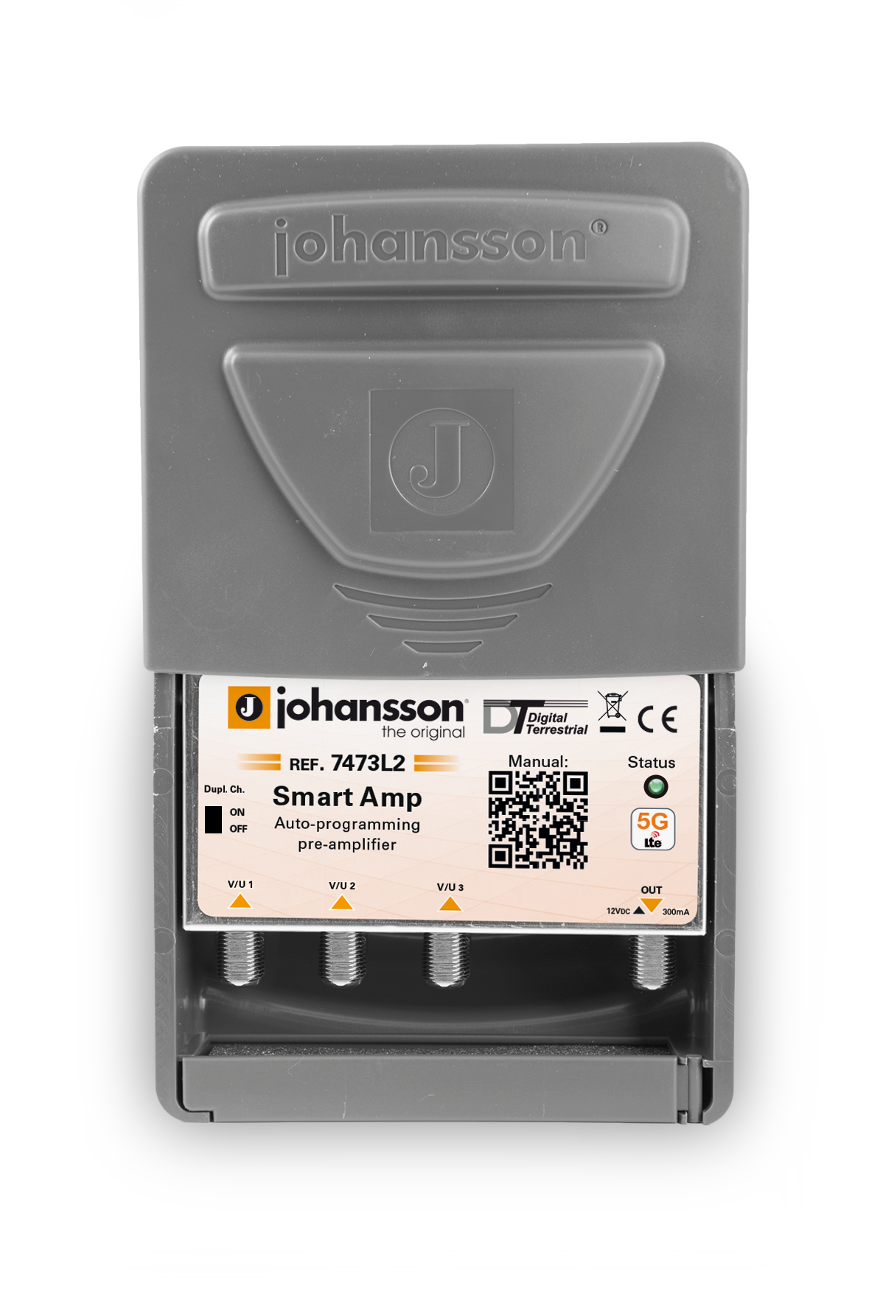
SMART AMP INSTALLATION
Combining 2, 3 or 4 antenna for full HDTV reception has never been so easy
PATENTED TECHNOLOGY

Slide 5
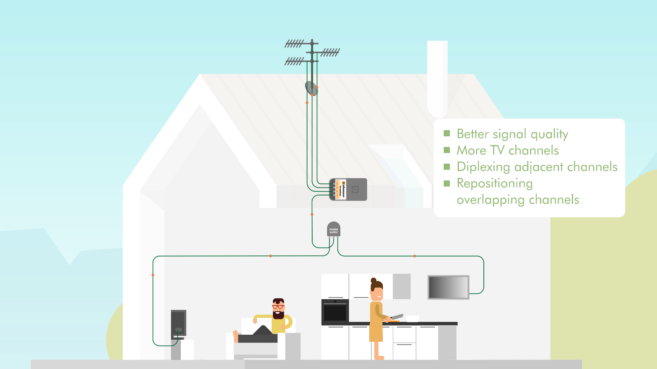
SMART AMP INSTALLATION
Better signal quality
More TV channels
Diplexing adjacent channels
Repositioning overlapping channels
POWER SUPPLY
PATENTED TECHNOLOGY

Slide 6
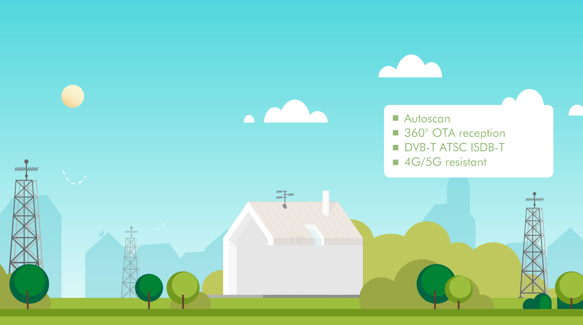
HOW IT WORKS
How it works
Autoscan
360° OTA reception
DVB-T/T2 ATSC ISDB-T
4G/5G resillient
PATENTED TECHNOLOGY

Slide 7
PRODUCT SPECIFICATIONS

Slide 8
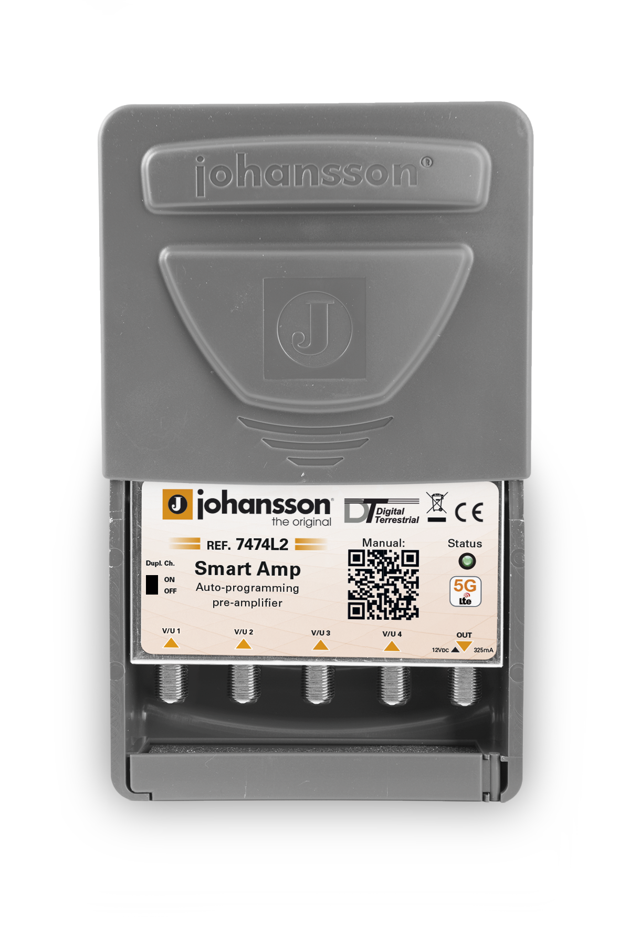
4 MODELS
7473L1
3 INPUTS
4G
7473L2
3 INPUTS
5G
7474L1
4 INPUTS
4G
7474L2
4 INPUTS
5G
PATENTED TECHNOLOGY

Slide 9
FEATURES
Scans all channels, amplifies the weak signals
while keeping the strong channels
All output channels have an equal and stable output power
Treats even the most difficult situations with adjacent channels
Channels with the same frequency can be amplified in and
re-located to the LTE band (switchable feature)
Fully automatic channel scan and process function upon start-up
PATENTED TECHNOLOGY

Slide 10
FEATURES
Fully automatic recognition of the applied country channel plan
SAW filters for LTE (4G or 5G) rejection on all inputs
Outdoor weatherproof mast-head housing
DC Power over coax
All ports ESD protected
PATENTED TECHNOLOGY

Slide 11
SPECS
SPECS LEAFLET
Parameter | Unit | KIT7473L1 | KIT7474L1 | KIT7473L2 | KIT7474L2
Inputs | - | 3 | 4 | 3 | 4
LTE rejection | - | 4G (>CH60) | 4G (>CH60) | 5G (>CH48) | 5G (>CH48)
Channel plan | - | VHF BIII + UHF Automatic channel plan selection
LTE band rejection | dB | >40
Output | - | 1
Output Power | dBµV | 85
Frequency range | MHz | 174 - 862
LTE band Re-use | - | L1 = CH61-69 (790MHz-862MHz) Switch ON-OFF |  | L2 = CH49-69 (694MHz-862MHz) Switch ON-OFF
Adjacent channel isolation | dB | >35
Input sensitivity | dBµV | minimum 40
Power | - | 12V/300mA (DC over coax) (350mA - 4 in)
Power Supply | - | External power supply (ref. 2437 - 2 out)
Dimensions | mm | 120 x 115 x 50
Operating temperature | °C | -20 to +50
PATENTED TECHNOLOGY

Slide 12
PRODUCT INSTALLATION

Slide 13
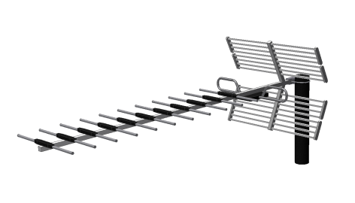
1 ANTENNA
How it works
Power
Supply
Smart Amp
ANTENNA 1
DC
TV1
TV2
PATENTED TECHNOLOGY

Slide 14
LTE1
REF. 7473L1
Power
Supply
CH21-60
LTE1
Smart Amp
CH21-60
LTE1
ANTENNA 1
DC
LTE1 = LTE800 = 4G
Everything above 790MHz is filtered out
TV1
TV2
PATENTED TECHNOLOGY

Slide 15
LTE2
REF. 7473L2
Power
Supply
CH21-48
LTE2
CH21-48
Smart Amp
LTE2
ANTENNA 1
DC
LTE2 = LTE700 = 5G
Everything above 694MHz is filtered out
TV1
TV2
PATENTED TECHNOLOGY

Slide 16
3 ANTENNA
Smart Amp
ANTENNA 1
DC
ANTENNA 2
ANTENNA 3
PATENTED TECHNOLOGY

Slide 17
3 ANTENNA
Smart Amp
CH21-48/60
LTE2/1
ANTENNA 1
DC
ANTENNA 2
ANTENNA 3
PATENTED TECHNOLOGY

Slide 18
CONVERSION ON
Smart Amp
CH21-48/60
LTE2/1
ANTENNA 1
Duplicate channel feature ON
DC
ANTENNA 2
ANTENNA 3
PATENTED TECHNOLOGY

Slide 19
CONVERSION ON
Smart Amp
CH21-48/60
LTE2/1
ANTENNA 1
DC
ANTENNA 2
DUPLICATED CHANNELS
IN LTE BAND
4G: 62 – 64 – 66 - … in steps of 2, then 61 – 63 –…
5G: 50 – 52 – 54 - … in steps of 2, then 49 – 51 – …
ANTENNA 3
PATENTED TECHNOLOGY

Slide 20
CONVERSION ON
Smart Amp
CH21-48/60
LTE2/1
ANTENNA 1
CH30
DC
ANTENNA 2
CH30
CH30
CH30
conv.
Duplicated channels ON:
weakest channel is converted to LTE band ;
CH30 > CH30 ➔ CH30 is transmitted
➔ CH30 is converted to LTE band
ANTENNA 3
PATENTED TECHNOLOGY

Slide 21
CONVERSION ON
Smart Amp
CH21-48/60
LTE2/1
ANTENNA 1
CH30
CH40
DC
ANTENNA 2
CH40
conv.
CH30
CH30
CH40
CH30
conv.
Duplicated channels ON:
weakest channel is converted to LTE band ;
CH30 > CH30 ➔ CH30 is transmitted
➔ CH30 is converted to LTE band
CH40 < CH40 ➔ CH40 is converted to LTE band
➔ CH40 is transmitted
ANTENNA 3
CH40
PATENTED TECHNOLOGY

Slide 22
CONVERSION OFF
Smart Amp
CH21-48/60
LTE2/1
ANTENNA 1
Duplicate channel feature OFF
DC
ANTENNA 2
ANTENNA 3
PATENTED TECHNOLOGY

Slide 23
CONVERSION OFF
Smart Amp
CH21-48/60
LTE2/1
ANTENNA 1
CH30
CH40
DC
ANTENNA 2
CH30
CH30
CH40
Duplicated channels OFF:
weakest channel is rejected;
CH30 > CH30 ➔ CH30 is transmitted
➔ CH30 is rejected
CH40 < CH40 ➔ CH40 is rejected
➔ CH40 is transmitted
ANTENNA 3
CH40
PATENTED TECHNOLOGY

Slide 24
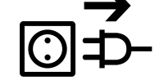
AUTOSCAN
PLUG-AND-PLAY
Plug in Power Supply
Status LED will blink when scanning
Status LED solid when autoscan ready
This can take up to 20 seconds
FORCE CHANNEL SCAN
= RESET = REPROGRAM
Unpower
Repower within 6 sec
Status LED will blink when scanning
If power interruption (>6 sec)
= no reprogram = settings are kept
PATENTED TECHNOLOGY

Slide 25
CONCLUSIONS

Slide 26
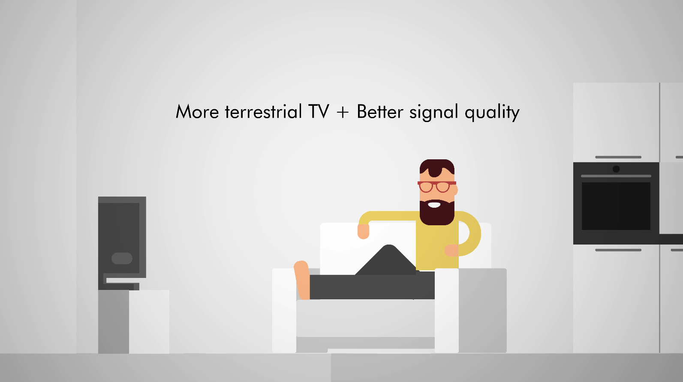
PATENTED TECHNOLOGY

Slide 27
Masz pytanie?
Napisz do nas!
sklep@dmtrade.pl
PATENTED TECHNOLOGY

